Slide 1
Swarm Intelligence
Bio-Inspired Algorithms By: Kunal Patel

Slide 2
Swarm Intelligence based algorithms Introduction, category
Nature Inspired algorithms
Bio-inspired Algorithms
Swarm Intelligence based algorithms
Non Swarm intelligence based algorithms
Physics and Chemistry based algorithms
Other algorithms

Slide 3
Swarm Intelligence based algorithms Introduction, Characteristic
Heuristic nonlinear optimization
Static optimization parameters taken as n-Dimentions
Escape from local minima
Convergence towards global minima
Balance between exploration(escape from local minima) and exploitation(approach towards minima)

Slide 4
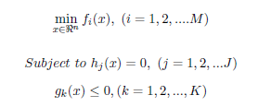
Swarm Intelligence based algorithms Introduction, General Implementation
Cost function to be optimized
N parameters
f(x) functions to be optimized, h(x),g(x) constrains

Slide 5
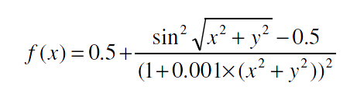
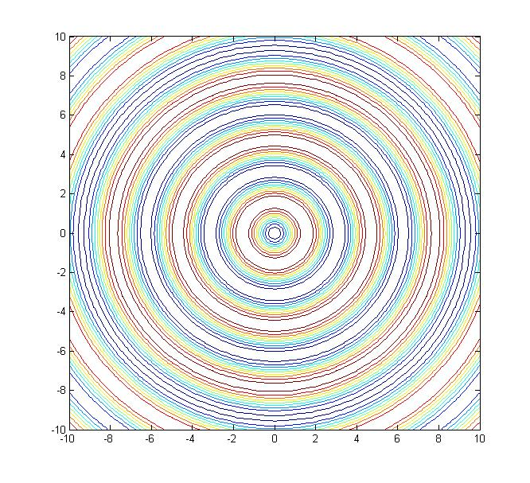
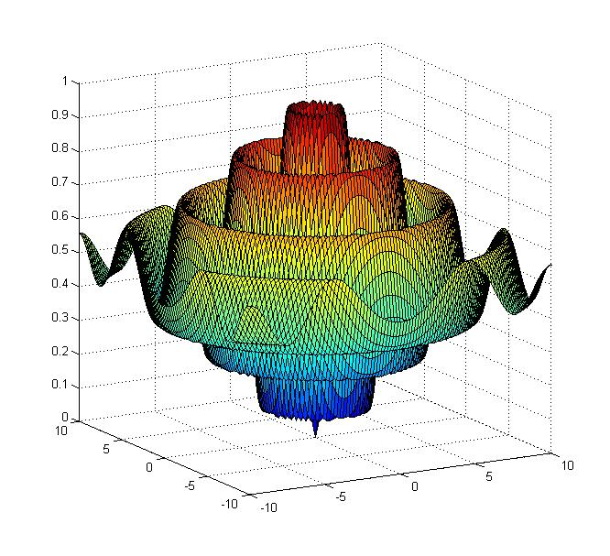
Schaffer’s F6 cost function

Slide 6
Swarm Intelligence based algorithms Introduction, General Implementation
Random Walk
Uniform distribution
Levi’s distribution
Normal distribution
Chaos maps based walk

Slide 7
Swarm Intelligence based algorithms Introduction, Limitation
Not guaranteed to reach global minima
As random stochastic path can not be predicted
Can get stuck in local minima
Requires parameters tuning for balance between exploration and exploitation for better result.
Parameters can vary based on cost functions used.
Computation intensive

Slide 8
Different Swarm based algorithms
Particle Swarm optimization algorithms
Wolf based search algorithms
Gray wolf optimization algorithm
Bat Algorithms
Firefly Algorithms
Artificial Fish swarm algorithm
Artificial Bee colony
Etc…

Slide 9
Wolf Based Search algorithm Introduction
Social predators, hunt in pack
Commute as a nuclear family
Semi-cooperative, move in group in loosely coupled formation
When hunting, simultaneously search for prey
Hunting individually, or in a group
If sign of prey found, howl and call other wolf
If sign of threats like hunter, run away to a far position

Slide 10
Demo
Wolf based Search algorithm

